Slide 1
Global COVID-19 Trend Analysis Dashboard
Data Visualization and Dashboarding Project
Prepared by
Samuel Precious Mmesoma
AnalystLab Internship Program
Date
29th May, 2026
Tools Used
Power BI

Slide 2
Dataset Overview
• Dataset Source: Johns Hopkins University COVID-19 Repository • Dataset Type: Global COVID-19 Time-Series Dataset • Data Included: - Confirmed Cases - Death Cases - Recovered Cases - Countries/Regions - Dates • Tools Used: - Microsoft Power BI - Power Query - DAX • Objective: To analyze global COVID-19 trends and communicate insights through interactive visualizations.

Slide 3
Business Problem
The COVID-19 pandemic affected countries differently across the world, leading to varying infection rates, death rates, and recovery outcomes. However, understanding these trends through raw datasets alone is difficult for decision-makers and healthcare stakeholders. This project aims to transform raw COVID-19 data into meaningful insights using interactive dashboards and visual storytelling to support better understanding of global pandemic trends.

Slide 4
Data Cleaning and Transformation
Steps Performed: • Imported CSV datasets into Power BI • Checked for missing values and inconsistencies • Renamed columns for readability • Unpivoted date columns for proper time-series analysis • Changed data types appropriately • Created calculated measures using DAX • Built relationships and prepared data for visualization

Slide 5
Key Performance Indicators (KPIs)
Total Confirmed Cases
Total Death Cases
Total Recovered Cases
Recovery Rate
Total Countries Analyzed

Slide 6
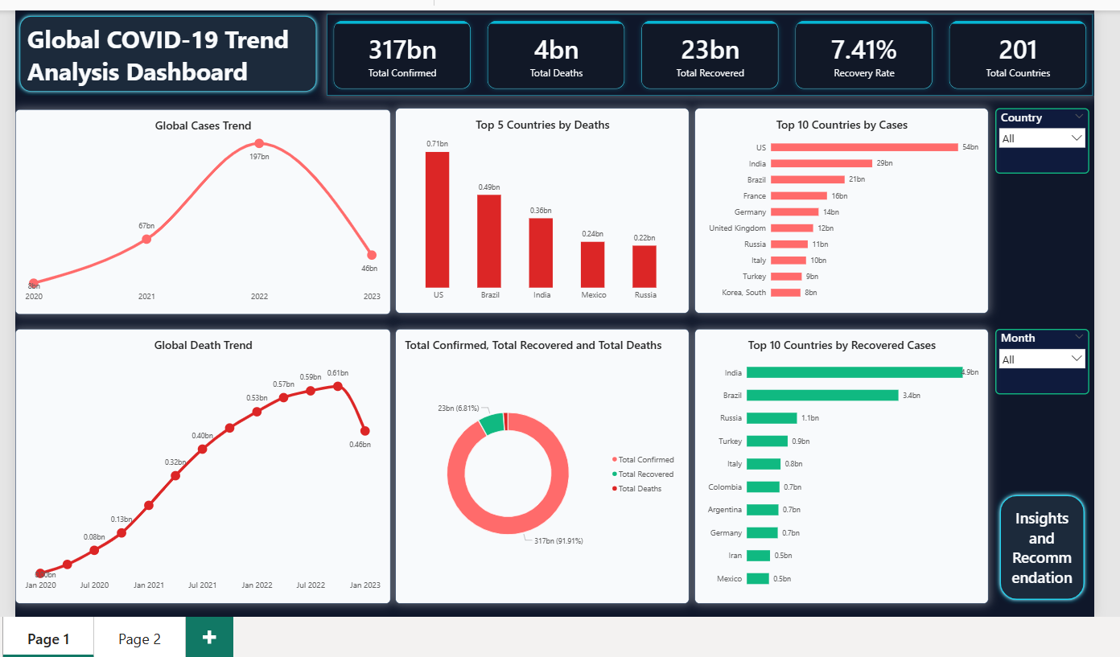
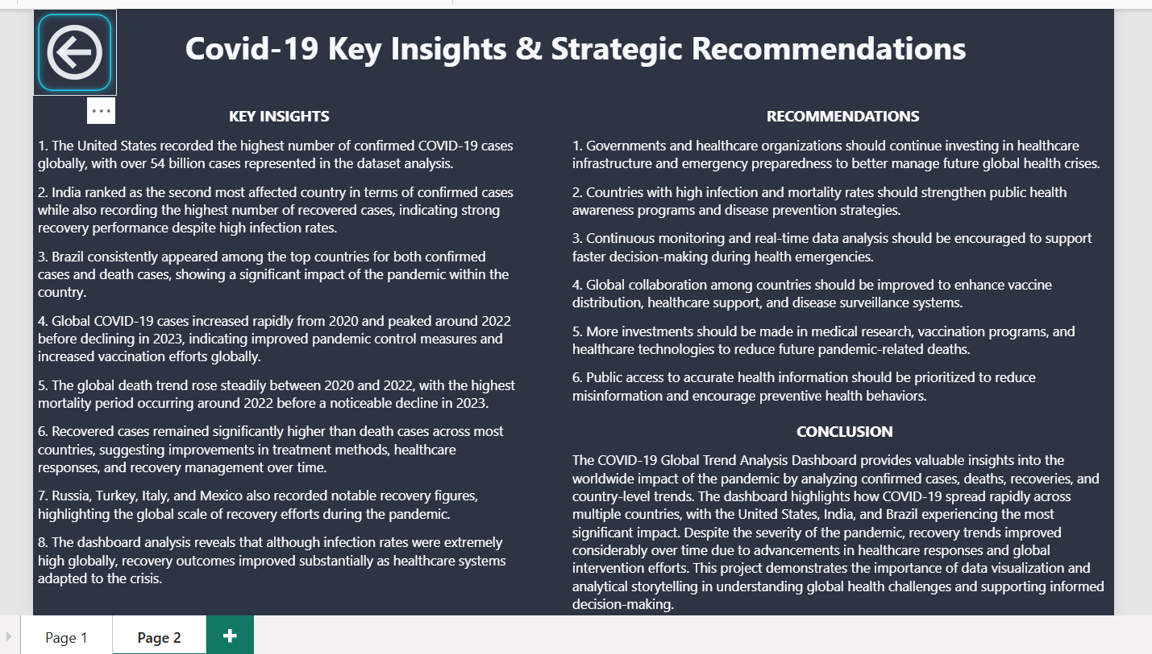
Dashboard Overview
The dashboard was designed to provide interactive analysis of global COVID-19 trends using filters, KPI cards, trend charts, and country comparisons.

Slide 7
Key Insights and Recommendations
Insights
• United States recorded the highest confirmed cases • India showed strong recovery performance • Global cases peaked around 2022 • Recovery trends improved significantly over time • Brazil recorded high cases and death counts
Recommendation
• Improve healthcare preparedness • Strengthen disease monitoring systems • Encourage global health collaboration • Invest more in healthcare infrastructure

Slide 8
Conclusion
This project demonstrates how data visualization can transform complex healthcare data into meaningful insights for decision-making. Using Power BI, interactive dashboards were developed to analyze global COVID-19 trends, recovery patterns, and mortality rates effectively.
THANK YOU

